Slide 1


Slide 2
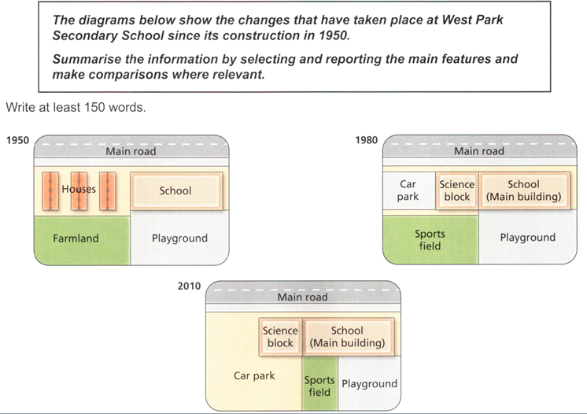
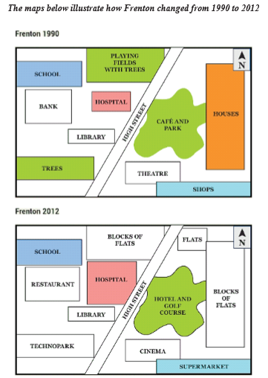
WRITING TASK 1 - MAPS
THESE MAPS ARE ALL MAN-MADE
-> PASSIVE VOICE

Slide 3
4 VITAL STRUCTURES - MAPS
Cái gì đó được thực hiện ở đâu.
Noun + (be) built | constructed | erected + Preposition.
Có cái gì đó được thực hiện ở đâu.
There (be) + Noun + (which + be) + PII + Preposition.
Ở đâu nhìn thấy “sự” thực hiện của cái gì đó.
The area | zone | field | site (see) | (witness) the construction | an erection of + Noun.
Năm nào nhìn thấy “sự” thực hiện của cái gì đó ở đâu.
Time (see) | (witness) the construction | an erection of + Noun + Preposition.
Notes:
Vẽ 1 hình trống -> có cái nhà – dùng từ gì miêu tả -> 4 cấu trúc

Slide 4
4 VITAL STRUCTURES - EXAMPLES
Noun + (be) built | constructed | erected + Preposition + (to do sth).
A number of houses are erected in the middle of the area (to provide accommodation for guests).`
There are a number of houses (which are) constructed in the middle of the area.
The middle of the area | zone | field | site sees | witnesses the construction | an erection of a number of houses.
(The year 2019) sees | witnesses the construction | the erection of a number of houses in the middle of the area.

Slide 5
VOCABULARY - MAPS
Replacement:
A (be) constructed | built | erected (cấu trúc số 1 – vital structures)
to replace B.
in the place of B.
as a replacement for B.
Thêm tương tự vào cấu trúc 2,3,4.
(ngược lại với riêng cấu trúc 1) B (be) turned into | converted into A.
B (be) demolished | torn down to make way for A.
The demolition of B (lead to) | (result in) the erection of A.
Notes:
Ngôi nhà A -> B: dùng từ gì? -> cấu trúc

Slide 6
VOCABULARY - MAPS
Directions:
Vital structures:
A + be + PII + to | in the North of B
There be A (which be) + PII + to | in the North of B
[In the North x to the North of]
There area (witness) the construction of A in the North of it.
(Time) (witness) the construction of A in the North of (the area).
Others:
To the North of B (be)/there (be) A.
Directions + replacement:
(The) A, which is in the left of (the) B, is built to replace C.
(The) C, which lies to the North of (the) B, is converted into A.
Notes:
To illustrate the meaning of this, refer back to the first maps; nếu muốn nói A được xây, thì xây ở đâu (hướng + 1 điểm làm gốc), bsung 1 số từ như mở rộng (expand/enlarge) – different from extend (length), swapped, relocation

Slide 7

Intro (paraphrase): The given maps depict how West Park Secondary School has been re-developed over a course of 60 years since its establishment in 1950.

Slide 8
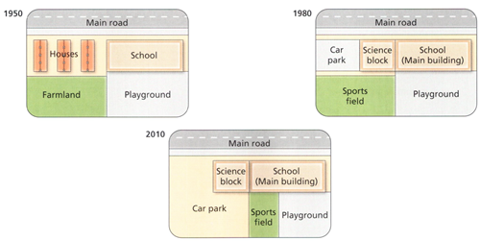
Overview: 2 sentences.
Describe the map generally.
The most noticeable difference(s) between the maps.
Questions to ask yourself:
Were the changes dramatic or minor?
What are the (2) significant changes in the area?
What is the effect of all the changes?
Notes:
Schools – car park (demolition of some facilities)

Slide 9
As can be seen from the pictures, there have been a number of radical changes occurring in the area, namely/including the expansion of the school and the erection of a car park AT THE EXPENSE OF some houses and a farmland. As a result, the school has become more modernized.

Slide 10
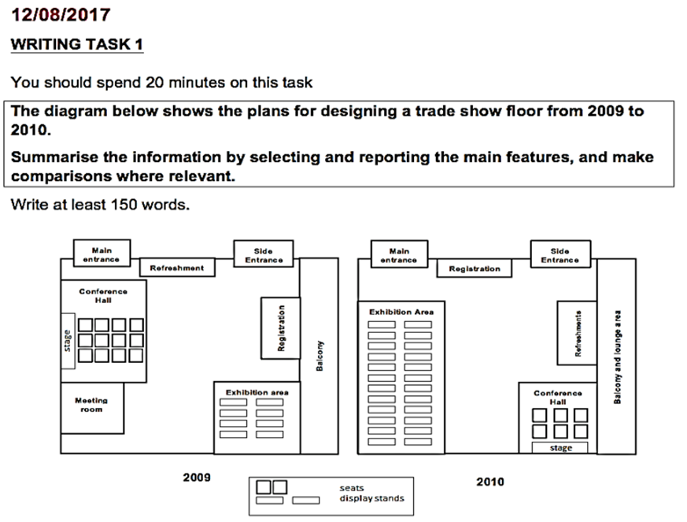
OVERVIEW _ PRACTICE
As can be seen from the maps, although certain areas of the floor remained at their previous locations, the design underwent radical changes. These include the relocation of facilities, transforming the floor to become more space-efficient/visitor-friendly.
Notes:
Swap – change places; (s1) exhibition area was built in … (S2) It was then relocated to … to swap places with …. (S3) Similarly, the refreshment area, which was situated …, changed place with … , with is located … The new registration area was sandwiched between …, whose location remained unchanged. – para 2: in 1990 – the meeting room was erected to the … of …. It was then… Meanwhile, there was an installation of the lougue area in the balcony, which was … - viết ra full

